Slide 1


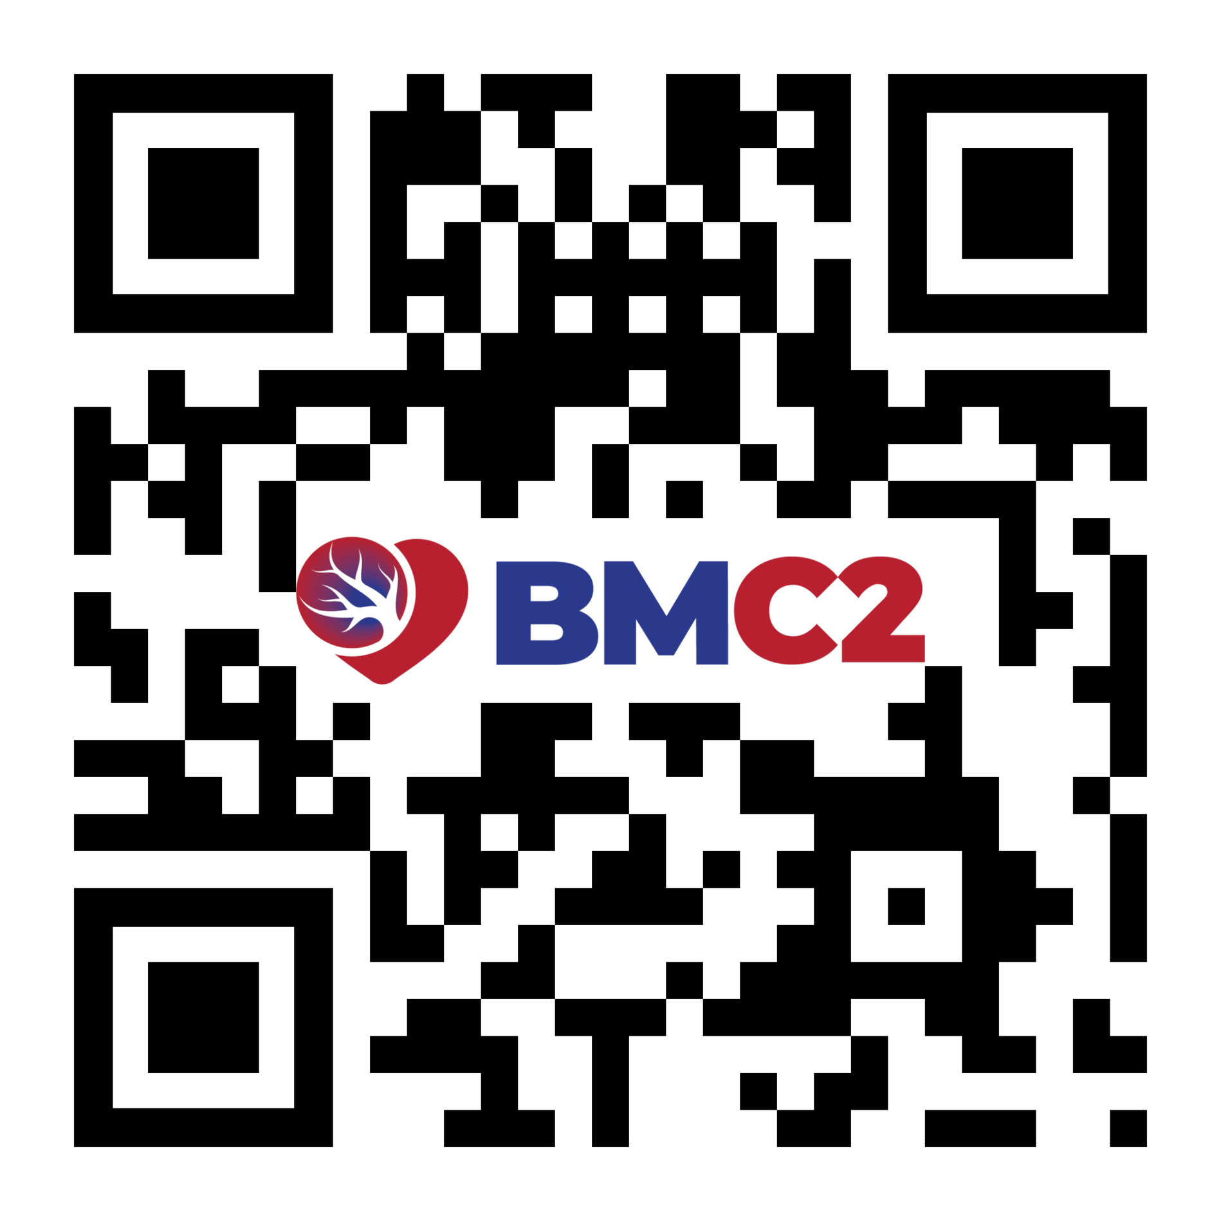


Poster Title Here - Montserrat bold 72 - 88pt
Affiliate logo(s) here
Authors Here Arial bold 24 - 44pt
Institutions Here Arial bold 24 - 36 pt
1
Section Title - Arial 48pt bold (copy and paste section titles as needed throughout)
Section Title - Arial 48pt bold
Section Title - Arial 48pt bold
Section text- Arial min 24 pt/max 42 pt (copy and paste section text as needed throughout)
Section text- Arial min 24 pt/max 42 pt (copy and paste section text as needed throughout)
Section text- Arial min 24 pt/max 42 pt (copy and paste section text as needed throughout)
Section Title - Arial 48pt bold
Section Title - Arial 48pt
Section text- Arial min 24 pt/max 42 pt (copy and paste section text as needed throughout)
Section Title - Arial 48pt
Section text- Arial min 24 pt/max 42 pt (copy and paste section text as needed throughout)
Section text- Arial min 24 pt/max 42 pt (copy and paste section text as needed throughout)
About BMC2
BMC2 is a collaborative consortium of health care providers dedicated to improving quality of care and outcomes for cardiovascular patients across the state
of Michigan.
bmc2.org
Support for BMC2 is provided by Blue Cross Blue Shield of Michigan and Blue Care Network as part of the BCBSM Value Partnerships program. Although Blue Cross Blue Shield of Michigan and BMC2 work collaboratively, the opinions, beliefs, and viewpoints expressed by the author do not necessarily reflect the opinions, beliefs, and viewpoints of BCBSM or any of its employees. Further, BCBSM does not have access to BMC2 data, and all patient episodes occurring at engaged hospitals are included in the data registries, regardless of payer.

