Slide 1
Introduction to the BMC2 Vascular Surgery Collaborative Quality Improvement (CQI)
Module I in the VS Site Coordinator Training
Notes:
Welcome to the Introduction to the BMC2 Vascular Surgery CQI training module.
This training module is intended for new VS coordinators and data abstractors, or anyone needs a refresher on the BMC2 VS consortium.
As a Vascular Surgery coordinator or data abstractor, you will playing a vital role in ensuring the successful continuation of BMC2 quality improvement efforts at your site. Your work will not only have a direct impact on your patients but also across the state of Michigan.

Slide 2
Introduction to BMC2
Notes:
The first segment of this training will cover BCBSM support, an overview of the BMC2 Consortium, and an explanation of how BMC2 Vascular Surgery collects data.

Slide 3
BCBSM Financial Support
Notes:
BMC2 is funded through Blue Cross Blue Shield of Michigan’s Value Partnerships.
This support consists of funding the Coordinating center budget, supporting the cost of data collection at regular Vascular Surgery sites, and incentive payments to participating facilities.
This funding enables hospitals and physicians to work in a collaborative environment, providing resources for data collection and analysis along with administrative oversight.

Slide 4
Notes:
BMC2 is Comprised of 3 Prospective, Multicenter Quality Improvement Registries
BMC2-PCI
BMC2-Vascular Surgery, and
Michigan Structural Heart Consortium (formerly Michigan TAVR)
The Vascular Surgery Consortium has collected information on over 50,000 cases from over 34 hospitals since 2012.

Slide 5
BMC2 Vascular Surgery Procedures
Open Abdominal Aneurysm Repair (OAAA)
Endovascular Abdominal Aneurysm Repair (EVAR), Infrarenal, Suprarenal, and Juxtarenal Repairs
Open Bypass Procedures, Upper and Lower Extremity
Open Thrombectomy Procedures, Upper and Lower Extremity
Carotid Stenting (CAS)
Carotid Endarterectomy (CEA)
Notes:
Our registry represents a regional collaborative effort to assess and improve quality of care and outcomes of patients undergoing a range of vascular procedures, including:
Open Abdominal Aneurysm Repair (OAAA)
Endovascular Abdominal Aneurysm Repair (EVAR), Infrarenal, Suprarenal, and Juxtarenal Repairs
Open Bypass Procedures, Upper and Lower Extremity
Open Thrombectomy Procedures, Upper and Lower Extremity
Carotid Stenting (CAS)
Carotid Endarterectomy (CEA)

Slide 6
BMC2 VS Data Collection
Notes:
VS data is entered into the BMC2 database accessible through the BMC2 website. More detailed trainings on navigating the BMC2 website, and the site coordinator’s data collection responsibilities will be covered in later training modules.

Slide 7
The CQI Model of Quality Improvement
BCBSM | Coordinating Center | Participating Hospitals
Notes:
Now that we’ve covered BCBSM support and had an overview of the BMC2 Consortium and Vascular Surgery data collection, we’re ready to move onto the next segment of this training. Next up, we’ll learn about the CQI model of quality Improvement: How BCBS of Michigan, the coordinating center and participating hospitals all work together to improve patient care.

Slide 8
The Collaborative Quality Initiative (CQI) Model
Three-part approach to quality improvement:
Funding from BCBSM
Coordinating Center
Participating Hospitals
BCBSM
CQI
Coordinating Center
Participating Hospitals
Notes:
The CQI model can be described as a three-part approach to quality improvement: Blue cross, the coordinating center, and participating hospitals.
With this collaborative approach hospitals and physicians across the state collect, share, and analyze data on patient risk factors, processes and outcomes, then design and implement changes to improve the safety and quality of patient care.
I’ll start first with the coordinating center by describing our role in this three part approach to quality improvement.

Slide 9
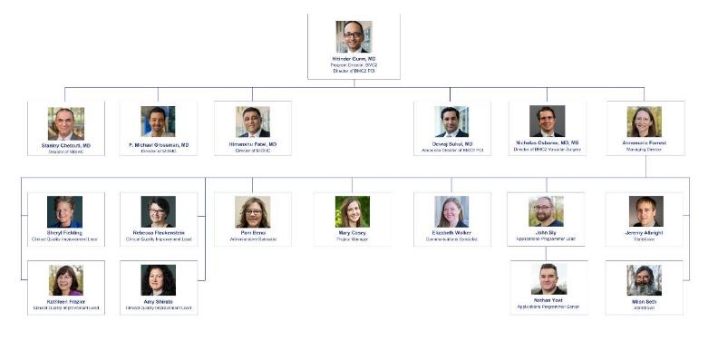
Coordinating Center
Notes:
These are the folks at the BMC2 Coordinating Center. BMC2 staff are U-M employees but support all hospitals participating in the BMC2 consortium.
Your primary contact for BMC2 Vascular Surgery is Rebecca Fleckenstein
At the BMC2 coordinating center, we are responsible for supporting and collaborating with the key players at participating hospitals. The Coordinating center serves as a data warehouse, conducting data audits and performing data analyses. We are also responsible for generating comparative performance reports, and planning and convening consortium meetings.
Now let's move on to the most crucial component of this three-part approach: BMC2 Vascular Surgery’s Participating Hospitals.

Slide 10
Key Partnerships and Their Roles
Physician Champion
Site Coordinator
Oversee site’s VS registry matters
Review all reports
Attend VS events
Provide clinical guidance to site’s VS team
Oversee data abstraction
Responsible for data submission, report distribution, meetings & trainings
Coordinate all VS efforts
Data abstractor
Participating Physician
Review medical record
Responsible for accurate interpretation of definitions and data entry into VS registry
Participate but not responsible for VS registry matters
Notes:
Each participating hospital plays an important role in the BMC2 Vascular Surgery consortium and the individual team members are key partners in our quality improvement efforts. Let’s do a brief overview of each important role.
The Physician Champion is a required role at participating sites. The physician champion is responsible for overseeing matters related to BMC2. They review all reports, Attend Vascular Surgery events and Provide clinical guidance to site’s Vascular Surgery team.
The Site Coordinator is also a required role for participating sites. The site coordinator oversees data abstraction, is responsible for data submission, report distribution, attending required meetings and trainings. The site coordination is the person that serves as a site representative responsible for coordination of BMC2 Vascular Surgery efforts. More information on the specific responsibilities for site coordinators will be covered in fourth training module.
The Data Abstractor is person responsible for review of medical record and entry of information into the registry. The data abstractor is expected to apply the correct interpretation of definitions and accurately enter data into Vascular Surgery registry.
A Participating Physicians are physicians who participate in BMC2 Vascular Surgery but are not responsible for registry matters.
Those individual team members are partners in successful implementation of BMC2 Vascular Surgery at our participating hospitals and each participating hospital plays an essential role the three-part approach to quality improvement.

Slide 11
The CQI Model
Physician performs an intervention
Focused efforts to improve procedural quality and safety
Lessons shared with everyone
Procedural data is abstracted from the medical record by the site coordinator
Reports are used to identify opportunities for improvement
Procedural data is sent to the Coordinating Center
Coordinating Center distributes reports for hospital and operator
Notes:
The CQI model of quality improvement begins when the Physician performs an intervention. In the case of BMC2 Vascular Surgery, that intervention is one of the six vascular surgery procedures.
You can see by this process map the procedural data is then abstracted from the medical record and sent to the coordinating center where is used to create hospital and physician level reports. This abstracted data is also used throughout the collaborative to identify opportunities for future improvement and focus our efforts on improving health care quality and safety, and ultimately sharing our lessons learned best practices with everyone.

Slide 12
The CQI Model
Decreased complications
It’s working…
Improved patient outcomes
Source: https://www.valuepartnerships.com/programs/collaborative-quality-initiatives/
Notes:
And this model is working. A subset of the CQIs have saved an estimated $1.4 billion in statewide health care costs, due to decreased complications and improved patient outcomes.
This award-winning model is the first of its kind, nationally, and is internationally recognized as an innovative approach to improving health care quality and value.

Slide 13
Notes:
At BMC2, we are proud of our consortium and the impact we’ve had on cardiovascular care in Michigan. Additionally, we are grateful to our participating hospitals for their partnership and to the site coordinators, physician champions, data abstractors and the participating physicians for their continuous dedication to this innovative approach to collaborative quality improvement.

Slide 14
BMC2 VS Clinical QI Lead
Rebecca Fleckenstein
VS Clinical Quality Improvement Lead
rflecke@med.umich.edu
Notes:
Whether you are a new site coordinator or are just viewing this training as a refresher, we’d like to thank you for partnering with us as a leader in this innovative and important quality improvement work. Your effort will benefits your site and your patients, as well as patients receiving cardiovascular care across the state of Michigan and beyond.
If you have any questions about your role throughout this orientation and beyond, we encourage you to reach out to the BMC2 Vascular Surgery QI Lead, Rebecca Fleckenstein.

Slide 15
Please proceed to
BMC2 VS Coordinator Responsibilities

